Slide 1

22nd IEEE International Symposium on Parallel and Distributed Computing
A new Ad-Hoc parallel file system for HPC environments based on the Expand parallel file system
Félix García-Carballeira
felix.garcia@uc3m.es

Slide 2
Agenda
Introduction to Expand Parallel file system
Expand as Ad-hoc parallel file system for large clusters and supercomputers
Motivation
Architecture
Data distribution
Metadata Management
Performance evaluation
Conclusions and future work

Slide 3
Introduction to Expand
Compute node
Application
POSIX
MPI
Intercept Library
Compute node
Compute node
Expand Client
NETWORK
I/O Node
I/O Node
I/O Node
Server
Server
Server

Slide 4
Expand: distributed systems and small clusters
Compute node
Application
POSIX
MPI
Intercept Library
Compute node
Compute node
Expand Client
NFS Connector
NETWORK
I/O Node
I/O Node
I/O Node
NFS
NFS
NFS

Slide 5
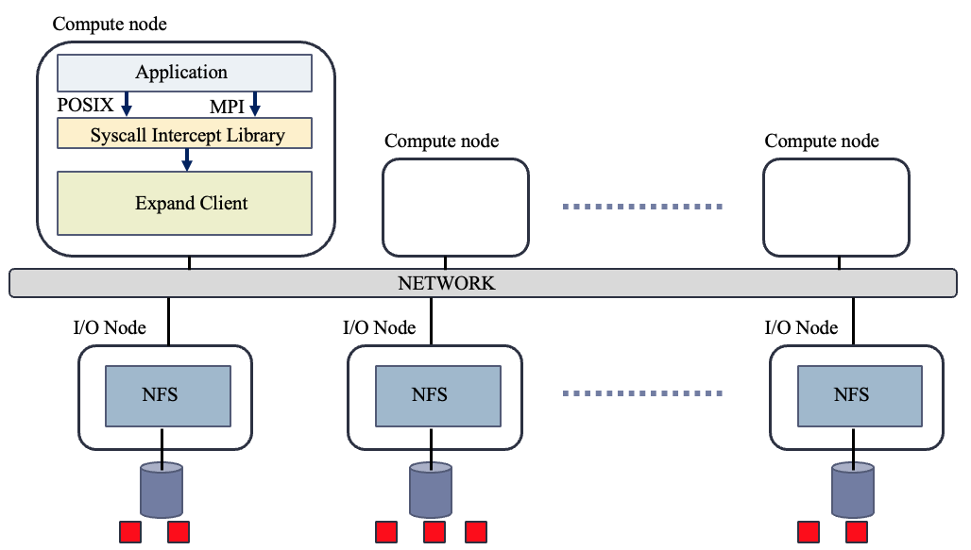
Expand: distributed systems and small clusters
Advantages of using NFS:
Standard server
No changes to NFS server are required
Independent of the operating system used in the clients
Allows the using of servers with different architectures and operating systems
The parallel file system construction is greatly simplified
NFS is very familiar to users: easy configuration

Slide 6
Expand: IoT environments
Compute node
Application
POSIX
MPI
Intercept Library
Compute node
Compute node
Expand Client
TCP/MQTT Connector
NETWORK
I/O Node
TCP/MQTT
I/O Node
TCP/MQTT
I/O Node
TCP/MQTT
Server
Server
Server

Slide 7
Expand: ad-hoc parallel file system for large clusters
Compute node
Application
POSIX
MPI
Intercept Library
Compute node
Compute node
Expand Client
MPI
NETWORK
I/O Node
MPI
I/O Node
MPI
I/O Node
MPI
Server
Server
Server

Slide 8
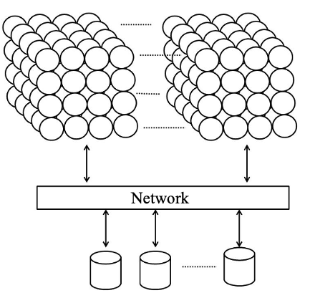
Motivation for developing an Ad-hoc file system
Typical supercomputer architecture:
The number of compute nodes is much larger than the number of I/O nodes:
Possible bottleneck
Compute nodes
I/O nodes
Backend parallel file system

Slide 9
Motivation for developing an Ad-hoc file system
Typical supercomputer architecture:
The number of compute nodes is much larger than the number of I/O nodes:
Possible bottleneck
Data away from applications:
Use of network
Reduces data access performance
Compute nodes
I/O nodes
Backend parallel file system

Slide 10
Motivation for developing an Ad-hoc file system
Typical supercomputer architecture:
The number of compute nodes is much larger than the number of I/O nodes:
Possible bottleneck
Data away from applications:
Use of network
Reduces data access performance
Different applications running at the same time:
File system conflicts and interferences
Compute nodes
App. A
App. B
I/O nodes
Backend parallel file system

Slide 11
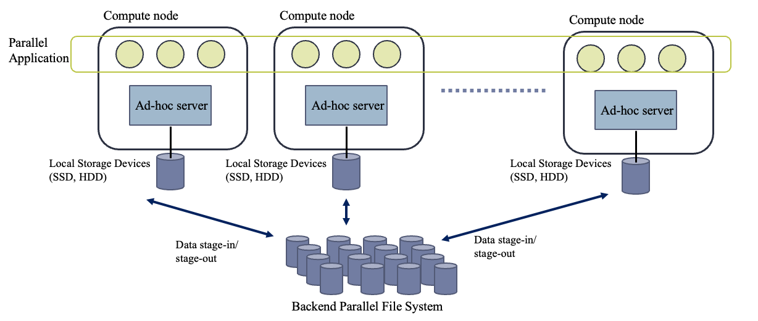
Ac-hoc file systems
Temporary storage system for single applications or workflows of applications that use the available storage of compute nodes (HDD, SSD or SHM)
The servers are deployed on the application's compute nodes

Slide 12
Ac-hoc file systems: advantages
Data close to the application
Increase the performance
Reduces network usage
Reduces backend file system access
Reduces bottlenecks
Temporary data (checkpoints, intermediate data) does not need to be stored in the backend file system
In application workflows data remains for the different workflow processes

Slide 13
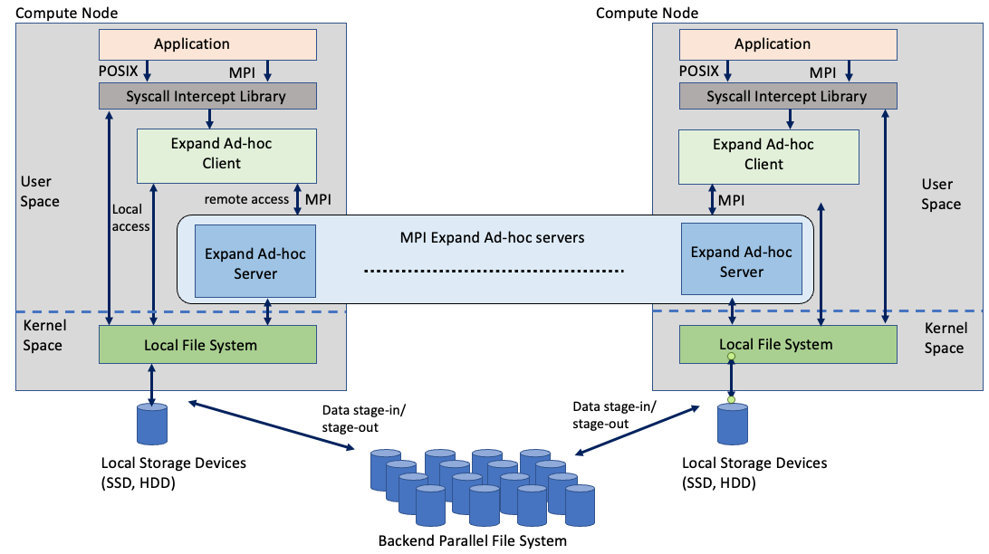
Architecture of the Expand Ad-Hoc

Slide 14
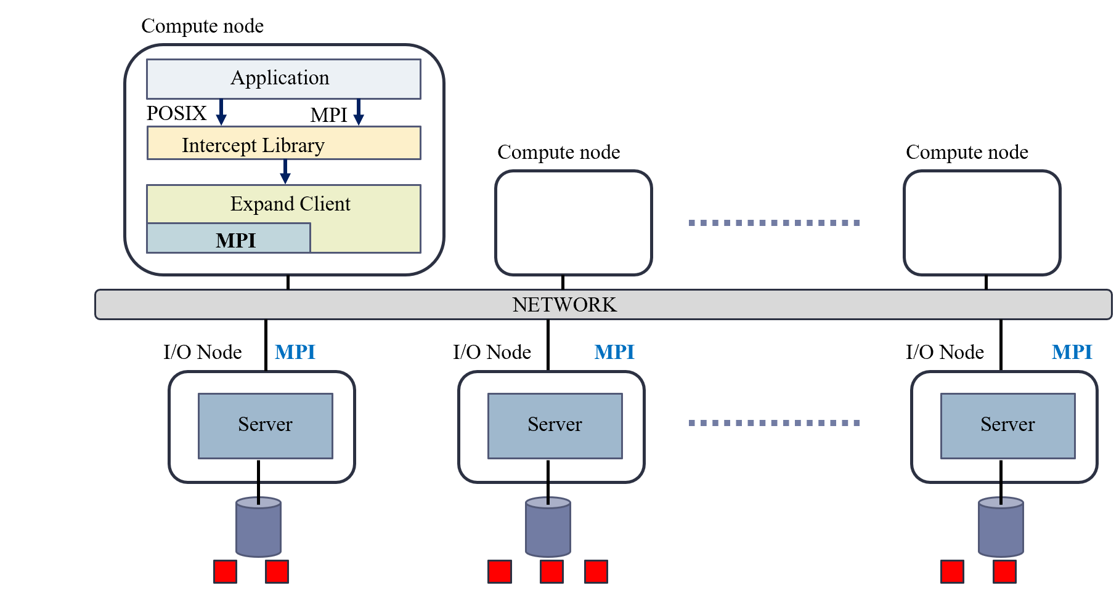
Architecture of the Expand Ad-Hoc
Advantages of using MPI:
Standard interface and portable to different platforms
Offers good performance in clusters

Slide 15
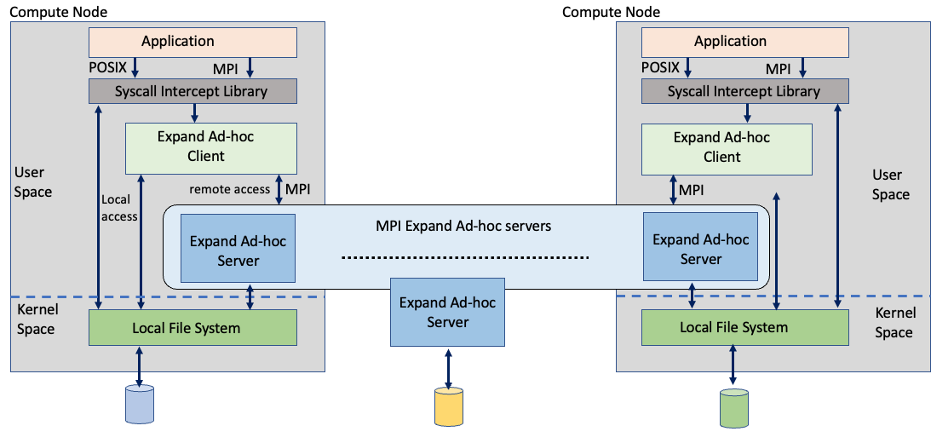
Data distribution
File in Expand
File in Expand:
Metadata subfile
Several data subfiles
Data distributed on different servers

Slide 16
Data distribution
File in Expand
File in Expand:
Metadata subfile
Several data subfiles
Data distributed on different servers

Slide 17
Data distribution
File in Expand
File in Expand:
Metadata subfile
Several data subfiles
Data distributed on different servers
subfiles

Slide 18
Data distribution
File in Expand
0
1
2
3
4
5
6
7
8
File in Expand:
Metadata subfile
Several data subfiles
Data distributed on different servers
0
1
2
subfiles
3
4
5
6
7
8

Slide 19
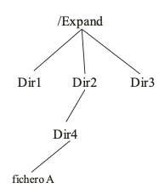
Directory structure
Logical View
Mapping
Physical View

Slide 20
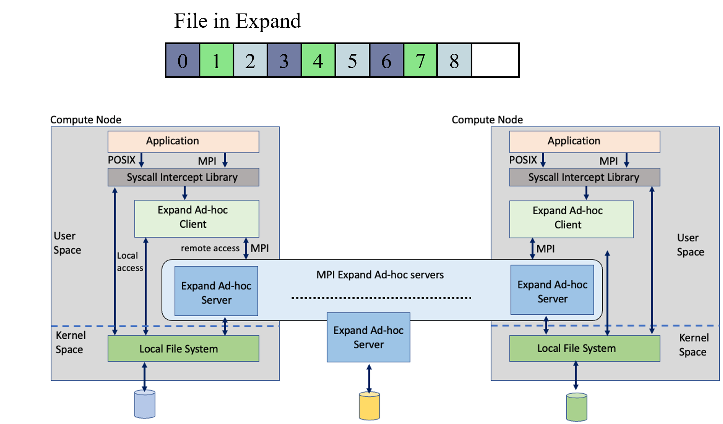
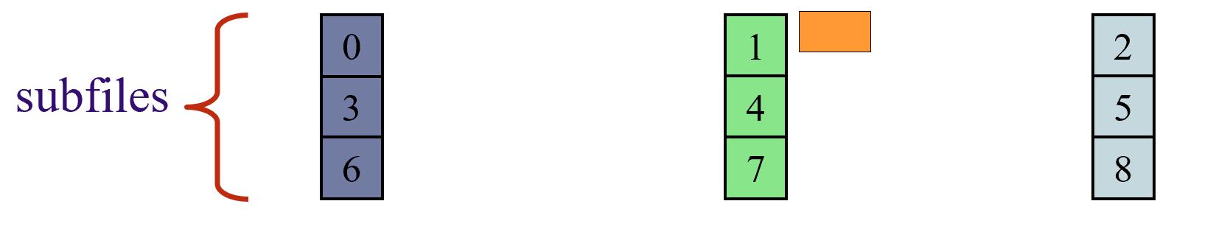
Metadata management
Distributed metadata management:
Two levels
No locks
No metadata manager
Metadata distributed among servers:
Master node
Hash function(name)
Load balancing

Slide 21
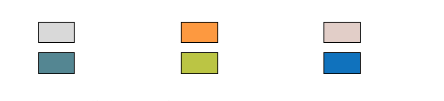
Metadata management
Distributed metadata management:
Two levels
No locks
No metadata manager
Metadata distributed among servers:
Master node
Hash function(name)
Load balancing
Metadata

Slide 22
Evaluation
Benchmark used: IOR
Open-source benchmark
A popular and effective way to evaluate the performance of distributed and parallel file systems is by using a variety of input/output (I/O) loads
IOR access pattern: file sharing
All processes share the same file
Challenge for most parallel file systems

Slide 23
Evaluation
Platform:
MareNostrum 4. Barcelona Supercomputing Center (BSC)
Main properties:
Nodes: 3,456
Total cores: 165,888
Main memory: 384.75 TB
SSD: 240 GB
Interconnection networks:100Gb Intel Omni-Path (Full-Fat Tree)
Peak Performance: 11.15 Petaflops
Parallel file system: GPFS

Slide 24
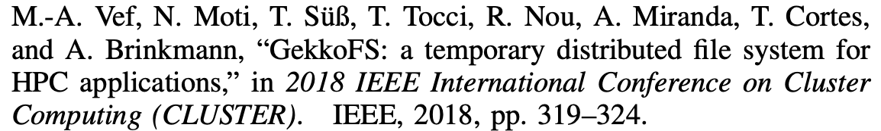
Evaluation
File systems evaluated:
Expand Ad-Hoc (512 KB of block size)
GekkoFS (512 KB of block size)
GPFS: parallel file system used in MareNostrum 4

Slide 25
Evaluation
Configuration:
Compute nodes: 1, 2, 4, ... up to 128 compute nodes
Local storage: SSD and Shared Memory (SHM) for GekkoFS and Expand
Transfer size used in IOR: 64 KiB, 512 KiB, and 1 MiB.
Client processes per compute node: 8
Operations: read and write in parallel on a shared file
Size written by each client: 4 GiB (resulting in a 4 TiB)
Number of processes: 8 up to 1024 processes
All results in logarithmic scale
All tests have been executed 10 times and the average results and standard deviation are shown in all figures.

Slide 26
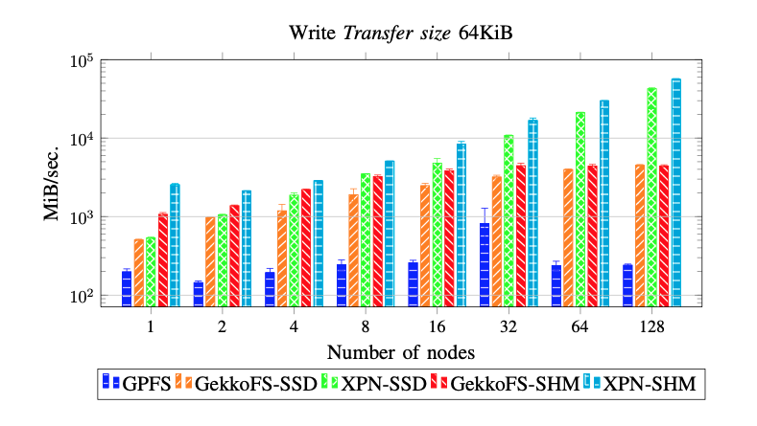
Results

Slide 27
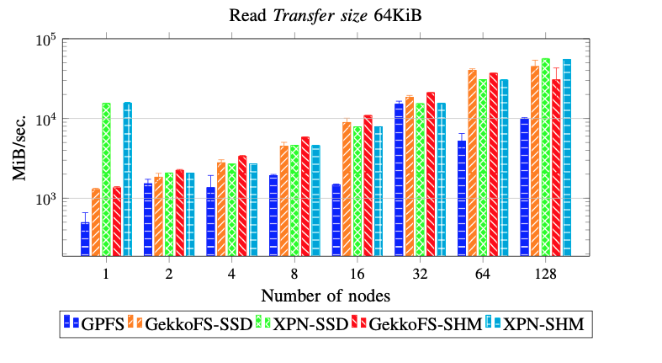
Results

Slide 28
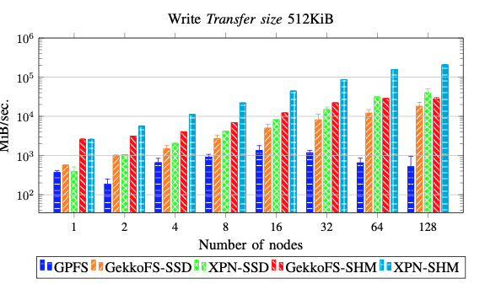
Results

Slide 29
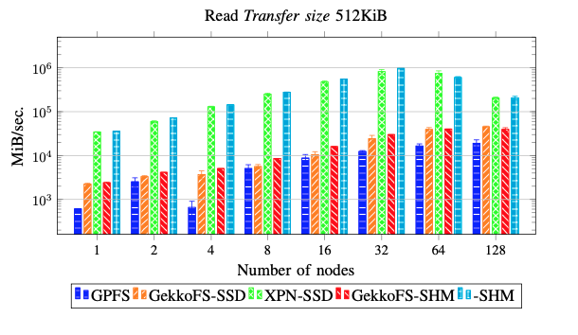
Results

Slide 30
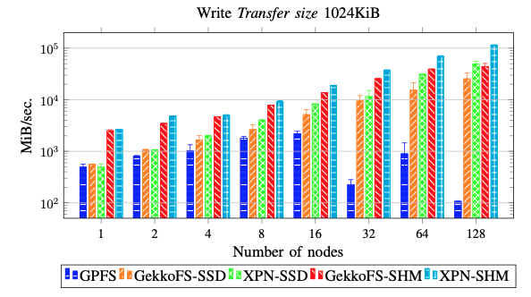
Results

Slide 31
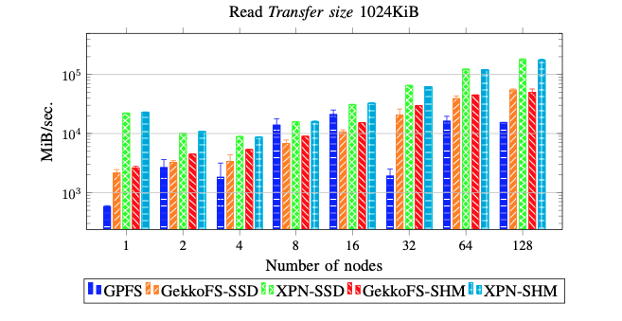
Results

Slide 32
Conclusions and Future Works
Main conclusions:
Expand Ad-Hoc is available as an open-source project in the following GitHub repository:
https://github.com/xpn-arcos/xpn
Expand Ad-Hoc uses user-space MPI-based data servers on the same compute nodes on which applications are running
Expand Ad-Hoc provides a good performance compared to other solutions
Future work:
Fault tolerant support

Slide 33
22nd IEEE International Symposium on Parallel and Distributed Computing
A new Ad-Hoc parallel file system for HPC environments based on the Expand parallel file system
Félix García Carballeira
felix.garcia@uc3m.es

Slide 34
Evaluation
Other results not included in the article:
A file per process. Each process accesses an individual file

Slide 35
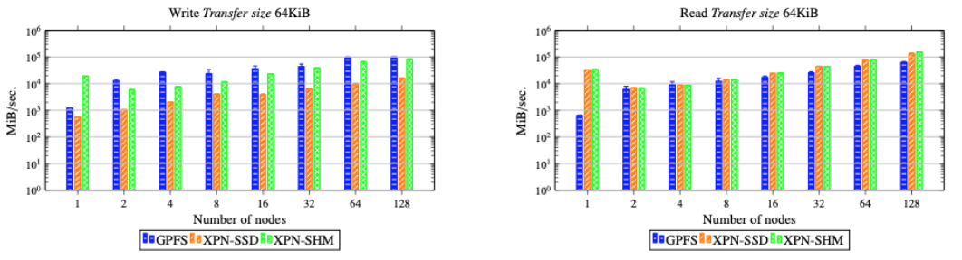
Results

Slide 36
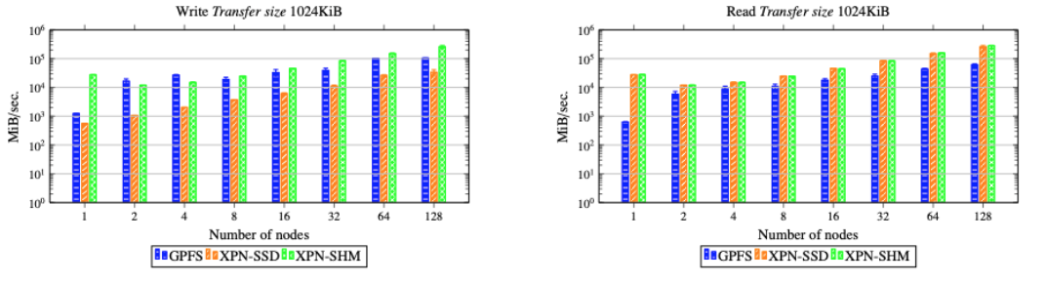
Results

